Slide 1
Drafting Hockey Players, a Model Approach
Sujith Xavier, Kurian
Siqi, Xiao
Joshua, Zhang

Slide 2
Introduction
Drafting
An annual event
Teams select the rights to eligible players
Worst performing teams from previous season select first
Effective way to acquire talent for cheap
Risky activity due to high chance of failure

Slide 3
Motivation
Drafting
On average, only 22.68% of all drafted players since 2005 have scored at least 10 points in the NHL
There are too many candidates to be scouted in person
Data Analysis in this space is in its infancy

Slide 4
Outline
Data Description
Modeling
Interpretation
Conclusion
Critique
Q&A

Slide 5
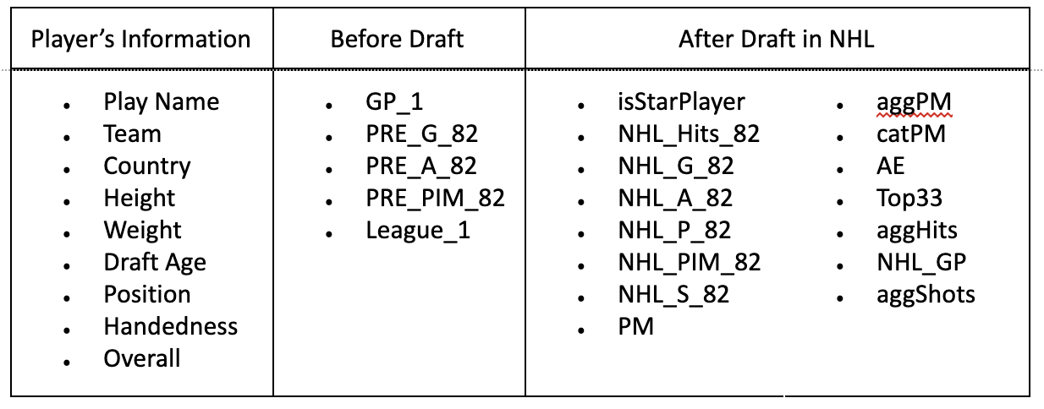
Data Description
Name of Dataset: Hockey Data.xlsx
Data Source: National Hockey League Official Website http://www.nhl.com/stats/
Data Description: Total of 472 active players’ information is collected from 1996 to 2019; 21 numerical and 7 categorical variables.

Slide 6
Data Description
Pre-Draft Data - The Predictors
Demographic Information
Country
Physical Metrics
Height, Weight, Handedness
Pre-Draft On-Ice Statistics
Goals
Assists
Penalty Minutes standardized to 82 game pace
Games Played
Pre-Draft League

Slide 7
Data Description
Post-Draft Data - The Response
Post-Draft On-Ice Statistics
Hits, Goals, Assists, Points, Penalty Minutes, and Shots standardized to 82 game pace
Action Events* (AE)
Subjectively defined: Penalty Minutes/2 + Goals + Assists + Hits +Shots
* All terms standardized to 82 game pace

Slide 8
Data Description
Transformation: Large variance exists in dataset; take log(AE) to stabilize the model
Data Validation: Training/Testing set = 0.75:0.25
Data Split: Split the whole dataset into forwards and defense based on 2 different positions in the game
Outliers Identification: 11 outliers are detected in Action Events, but we kept them

Slide 9
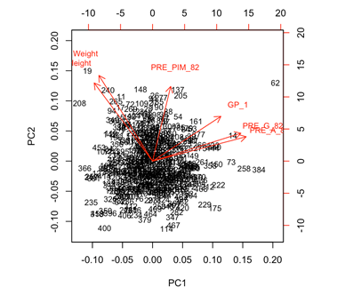
Modeling
PCA
Variables:
6 4
Notes:
The optimal number of PC is 4, and 91% of variance explained by below 4 principal components
PC1 is the performance of the hockey players regarding goals and assists before draft
PC2 is the body measurement of the hockey players
PC3 is the penalty minutes in hockey games
PC4 is Games played in the year leading up to the player’s draft eligible draft.

Slide 10
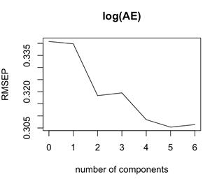
Modeling
PCR
Variance Explained: 95.73%
Test MSE: 307.9919

Slide 11
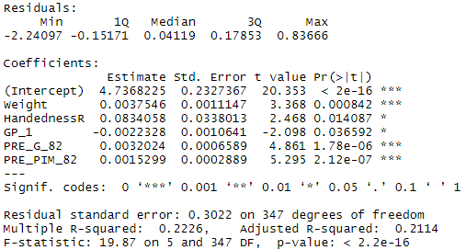
Modeling
Linear Regression - Full Dataset
Variables:
Weight
Handedness
Games Played
Goals Scored
Penalty Minutes
Important Metrics:
Adj. R²: 0.2114
p-value: < 2.2e-16
Test MSE: 307.9922

Slide 12
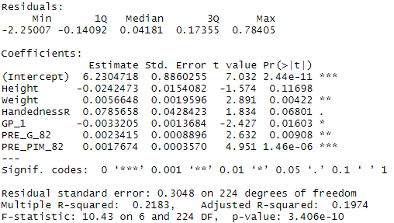
Modeling
Linear Regression - Forwards
Variables:
Height
Weight
Handedness
Games Played
Goals Scored
Penalty Minutes
Important Metrics:
Adj. R²: 0.1974
p-value: 3.406e-10
Test MSE: 315.9038

Slide 13
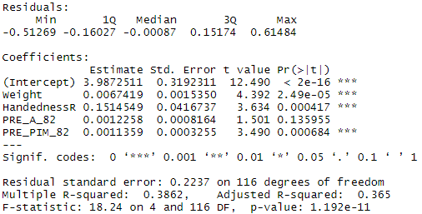
Modeling
Linear Regression - Defense
Variables:
Weight
Handedness
Assists Given
Penalty Minutes
Important Metrics:
Adj. R²: 0.365
p-value: 1.192e-11
Test MSE: 294.1469

Slide 14
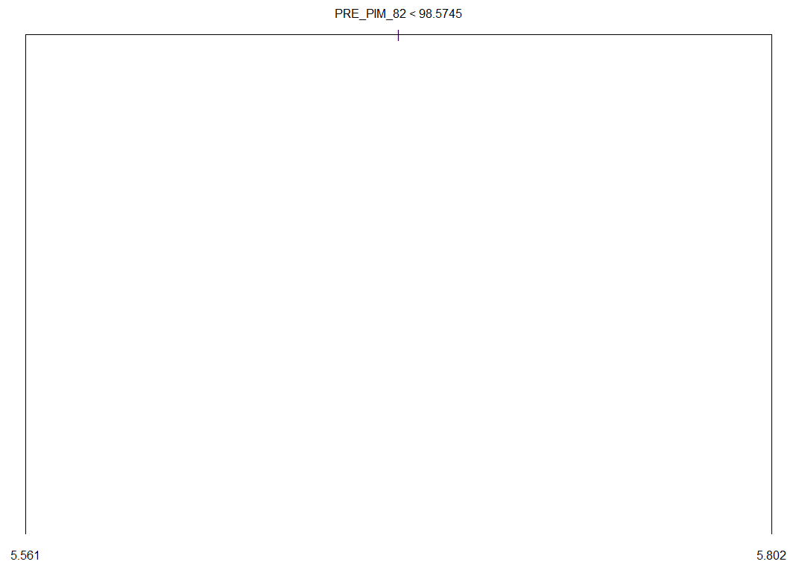
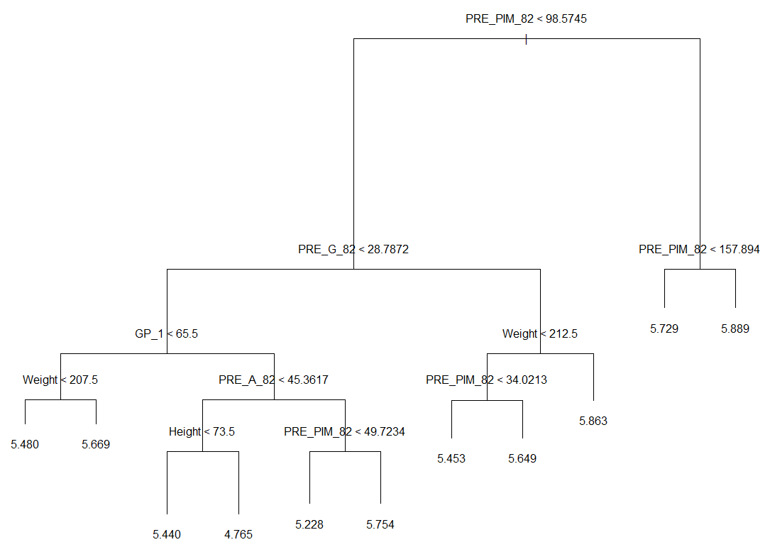
Modeling
Regression Trees - Full Dataset
Variables:
Penalty minutes
Goals Scored
Games Played
Weight
Assists Given
Height
Important Metrics:
Test MSE: 308.0036
Notes:
Variables actually used in tree construction

Slide 15
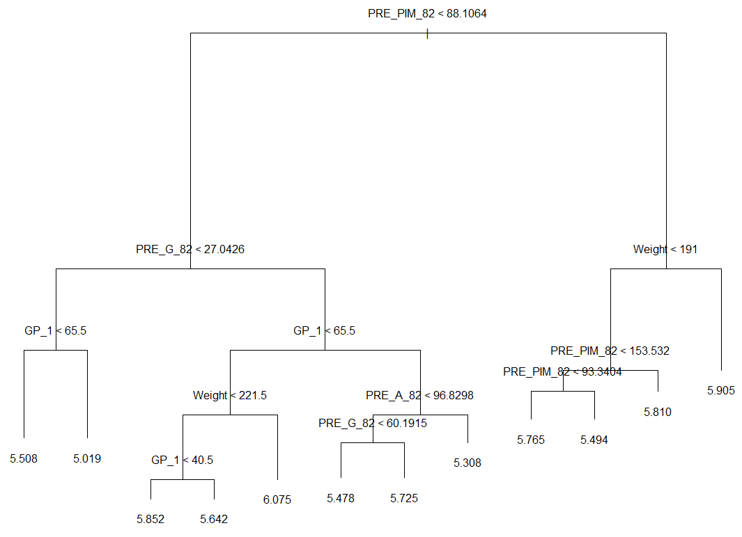
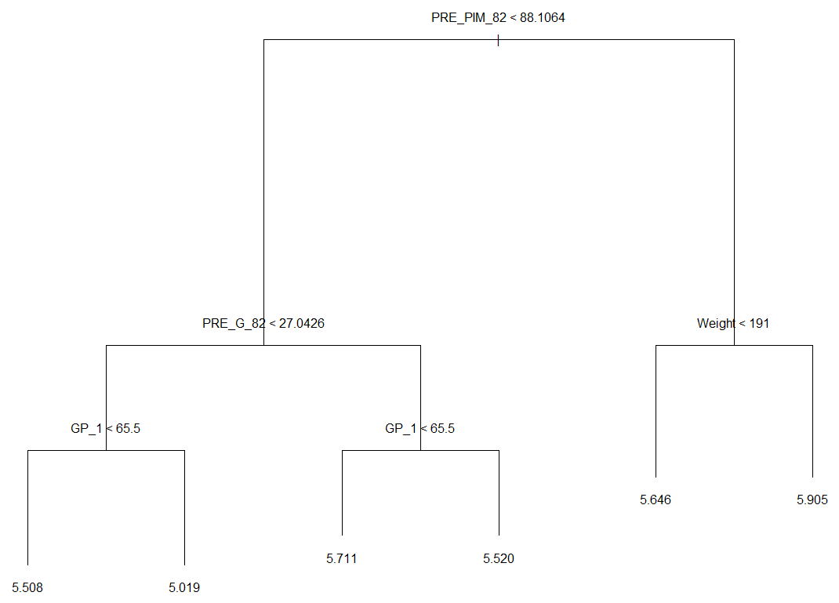
Modeling
Regression Trees - Forwards
Variables:
Penalty Minutes
Goals Scored
Games Played
Weight
Assists Given
Important Metrics:
Test MSE: 315.9015

Slide 16
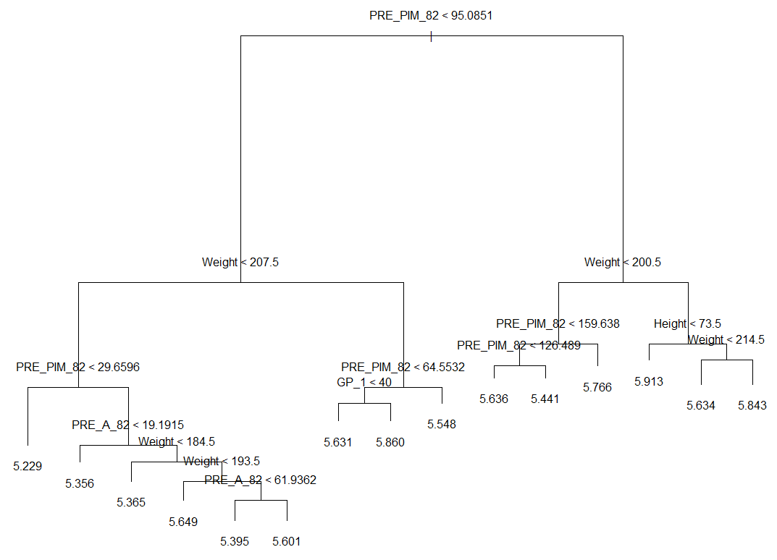
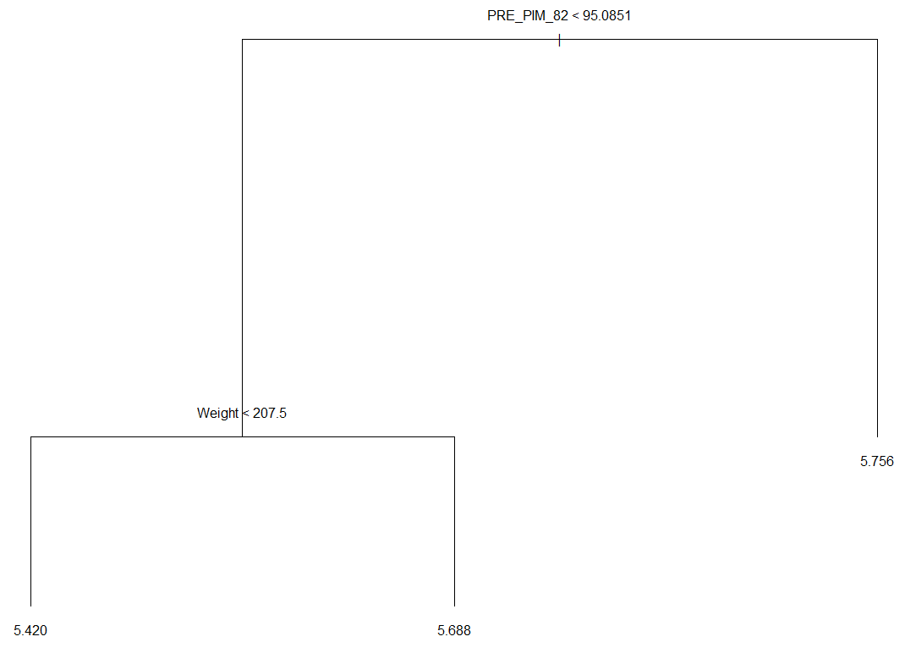
Modeling
Regression Trees - Defense
Variables:
Penalty Minutes
Goals Scored
Games Played
Weight
Assists Given
Important Metrics:
Test MSE: 294.1018

Slide 17
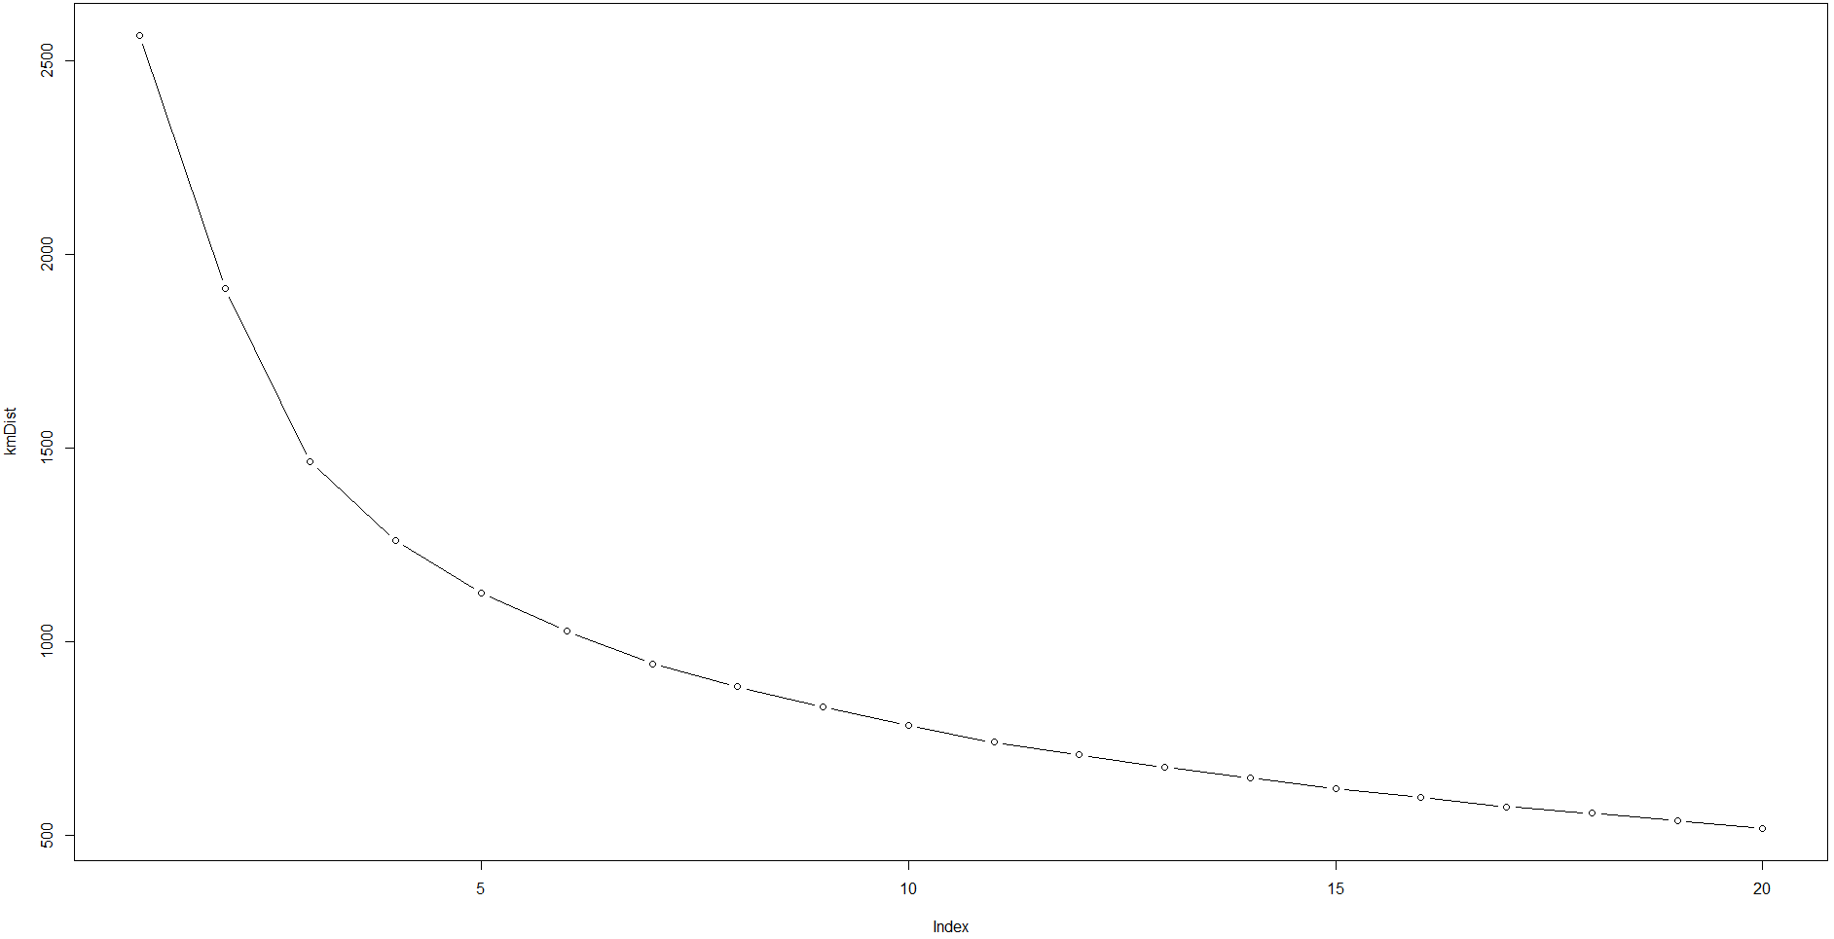
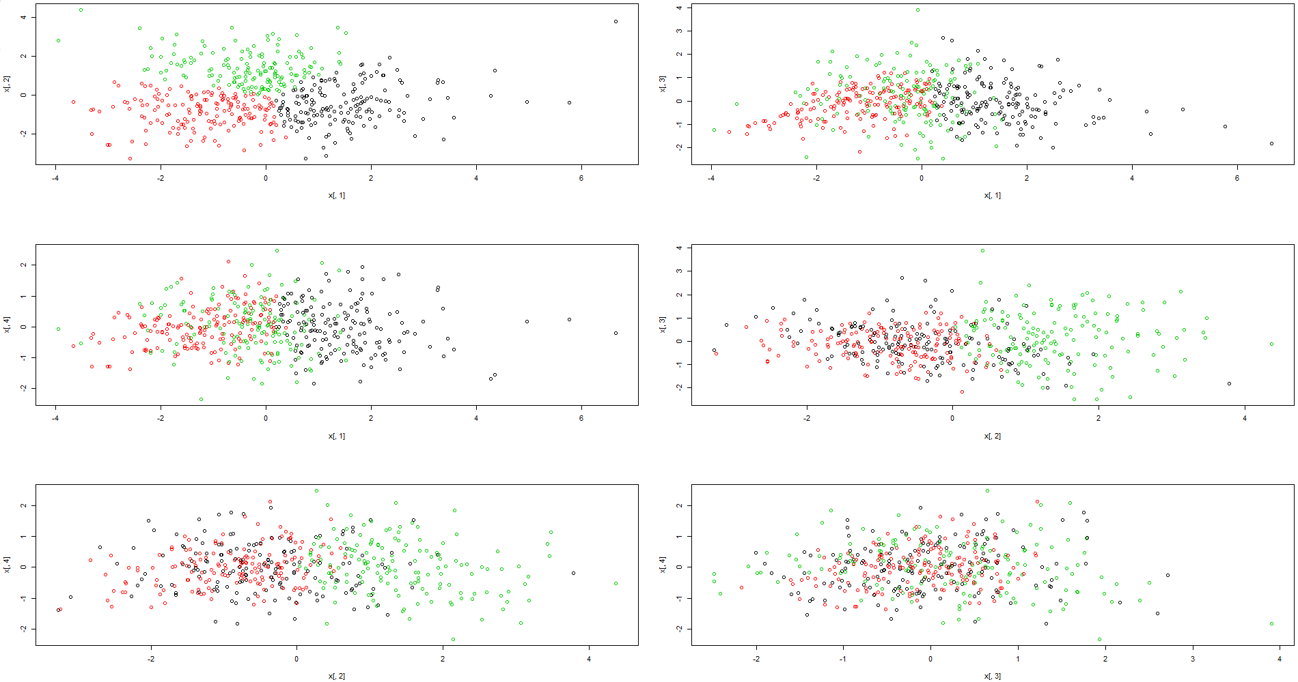
Modeling
Clustering
Number of PC: 4
Number of Clusters: 3

Slide 18
Interpretation
Linear Regression
Weight, Handedness and Penalty in minutes are the common predictors.
Defense model has the lowest testing error and the highest Adj.R²
Weight , Handedness, Goals scored, Penalty Minutes are positively related to Action Events, whereas Games Played has a negative relationship.
Group | Optimal Tree Size | Tree Testing Error | lm Testing Error | Adjusted R²
Combined | 2 | 308.0036 | 307.9919 | 0.2114
Forwards | 6 | 315.9015 | 315.905 | 0.1921
Defense | 3 | 294.1018 | 294.1441 | 0.3582
Notes:
Games played has an inverse relationship with AE, meaning more games played pre-draft means less impact on the ice.

Slide 19
Interpretation
Regression Tree
Penalty Minutes the most important factor which defines Action Events of a player.
Pruned Regression Tree for Combined data has only Penalty in minutes
Pruned Regression Tree for Forward player have following variables.
Penalty in minutes
Goals scored & Weight
Games played
Pruned Regression Tree for Defense player have following variables
Penalty in minutes
Weight
.

Slide 20
Conclusion
Opportunities to identify more predictors which can further improve the overall performance of the model.
Total Penalty in minutes, Goals scored, Games played and Weight are the key factors that decide the overall performance of a player to be successful in the NHL.
Penalty in minutes the most important factor
The models provide a methodical process to pick a draft player that will be successful in the NHL.

Slide 21
Critique
Identify more predictors which can further improve the overall performance of the model
Include data from drafted players that did not play in the NHL
Response variable is subjectively created
Non-quantitative factors might also has an impact on player’s performance
Notes:
Non-quantitative factors like player psychology, injury, intangibles

Slide 22
Thank you!
Any Questions?
Go Bruins!

